Slide 1
Industrial Economics PPT - 9
Market Structure
An Orientation to Markets, Market Structures - Typology,
Structure, Conduct, Performance,
Entry Barriers, Exit Barriers, Market Concentration

Slide 2
5 Key Words associated with Markets
Revenue
Costs
Elasticities
Technology
Consumer Tastes & Preferences

Slide 3
Why are we interested in market structures?
Structure
The structure of the market is affected by demand and supply -
Example: 31 NIT, 23 IIT
What factors might cause variation in the structure, conduct, and performance of different business?
Conduct
- Which impact the aims and objective of firms -
Example: fees, placement
Performance
- Which in turn influences their performance.
NIRF ranking, patents

Slide 4
Why are we interested in market structures?
Structure
How much market share a firm has?
Do products differ or are they the same?
Conduct
Do firms work in isolation?
Are their action inter-dependent?
How do they compete?
Performance
Do they seek to maximize profit?
Efficiency? (productive & allocative)
Dynamism?

Slide 5
What do we mean by Market Structure?
At its simplest – it is a description of the characteristics that buyers and sellers encounter in a given industry.
Variables
Number of firms
Power and quantity of buyer
Consumer loyalty
The market share of firms
Degree of product differentiation
Profitability
Nature of cost

Slide 6
Same but different! 60 second challenge
Match up the businesses that provide a similar service.
Then try and think about how they could also differ.
On the next slide you will see a number of different businesses.
Pair up the businesses that you think are similar
Then try to find one difference between each
Use the variables we just covered to help you!

Slide 7
Same but different! 60 second challenge
Apple grower in Jammu & Kashmir
Reliance Fresh,
Kunnamangalam
Reliance Petroleum Ltd
Big Mart Super Store, Kattangal
Mister Cut Gents Beauty Parlour, Kattangal
Indigo Airlines
Jet Airways
Indian Oil Corporation
Apple grower in Himachal Pradesh
Like Me Family Beauty Hub,
Kattangal

Slide 8
Same but different! 60 second challenge
Apple grower in Jammu & Kashmir
Reliance Fresh,
Kunnamangalam
Reliance Petroleum Ltd
Big Mart Super Store, Kattangal
Mister Cut Gents Beauty Parlour, Kattangal
Indigo Airlines
Jet Airways
Indian Oil Corporation
Apple grower in Himachal Pradesh
Like Me Family Beauty Hub,
Kattangal

Slide 9
What is the significance?
Apple grower in Jammu & Kashmir
Apple grower in Himachal Pradesh
Does an apple cultivator in J&K compete with a apple cultivator in HP?
A farmer from J&K can produce as many apples as they want and not affect the sales and profit of the farmers of HP. Ultimately the explanation lies within the explanation of structure of the market.
Indigo Airlines
Jet Airways
Indian Oil Corporation
Reliance Petroleum Ltd
Indigo Airlines and Jet Airways compete with one-another and they will try to influence the price that each other charge for the flight ticket.
Reliance Fresh
Kunnamangalam
Big Mart Super Store Kattangal
Mister Cut might compete with Like Me for business, but this competition depends on the location of the businesses.
Mister Cut Gents Beauty Kattangal
Like Me Family Beauty Hub
Kattangal
The structure of a market place influences who competes with whom, the aims & goals of firms and the potential rewards.

Slide 10
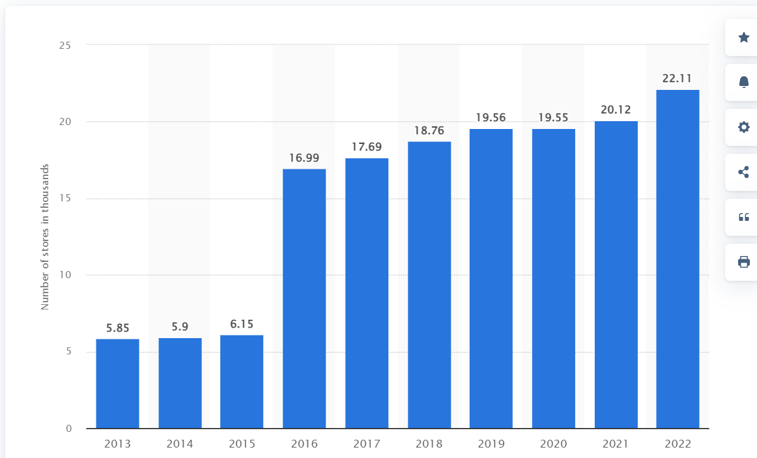
Number of modern retail grocery outlets across India from 2013 to 2022 (in 1,000s)
What factors might account for this increase?
© Statista 2023

Slide 11
Possible thoughts…
Increase in the disposable income of the buyers.
Reduction in the rents in certain areas.
Sellers offering slightly different services.
Example: home delivery, reward points for purchases
Increase in the number of business groups or business consultants.
The availability of financial capital such as easy loans.
You could think or bring variety of reasons!
The key takeaway is that by investigating the market structures, we will be able to answer the reasons behind such questions.

Slide 12
Two Classification Systems for Firms
In what type of competitive environment does the business operate?
2) How has the company chosen to organize itself?

Slide 13
Familiarizing the Key Terms
Pure competition
Monopolistic competition
Oligopoly
Monopoly
Sole proprietorship
Partnership
Corporations
Ordinance
Product differentiation
Intellectual property
Liability
Financial capital
Profit

Slide 14

MARKET
In economics, market is defined as a complex set of activities by which potential buyers and potential sellers are brought in close contact, for the purchase and sale of a commodity.

Slide 15
Market: Introduction
The word market is derived from the Latin term mercatus from the verb mercari which means “to trade”.
In simple terms, market is a place where goods are bought and sold.
In economics, Markets have certain characteristics. They are as follows:-
There should be a large number of buyers and sellers of a commodity.
There must be communication between buyers and sellers.
There must be a place or area where buyers and sellers interact with each other (physical or virtual space).
There must be a commodity which is being demanded and sold.
There must be freedom of entry or exit of the firms. Different forms of markets are differentiated from each other in terms of the nature of entry or exit.

Slide 16
Classification of Markets
(1) Area-wise Classification: Based on area, markets are classified as:
Local Market,
Regional Market,
National Market,
International Market.
(2) Classification according to Time: Markets can also be classified on the basis of the time taken by producers to adjust supply.
(3) Functional Classification: According to the functions they perform, there are two types of markets – Generalised markets and Specialised markets .

Slide 17
Market Structure
A market facilitates the interaction of a buyer and a seller as they complete a transaction
Buyers, as a group, determine the demand
Sellers, as a group, determine the supply
Type of market structure influences how a firm behaves in terms of:
Pricing
Supply
Barriers to Entry
Efficiency
Competition
In what type of competitive environment does the business operate?
Notes:
One seller – monopoly
One buyer – monopsony

Slide 18
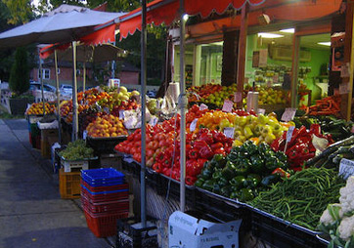
Competitive Markets
Identical goods or services
Enough number of buyers and sellers, so that no participant can influence the market price on their own – everyone is a price taker
Perfect information available to buyers and sellers
Free entry and exit to industry
Notes:
One seller – monopoly
One buyer – monopsony

Slide 19
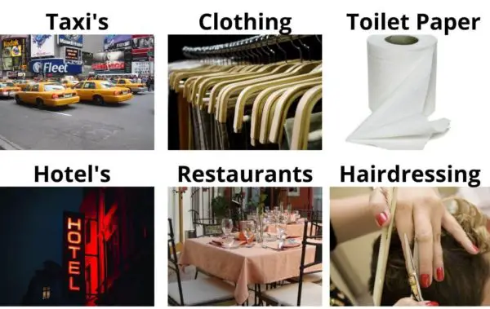
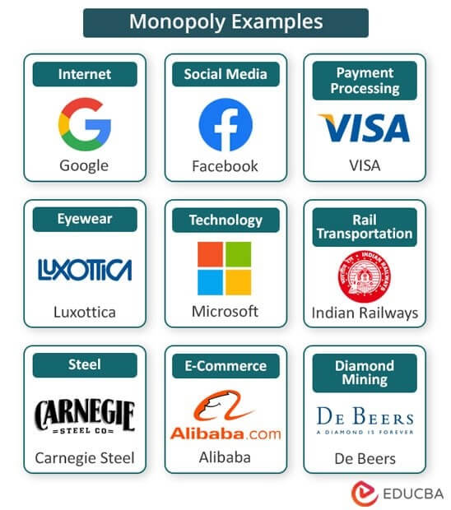
Imperfect Competition
Goods or services that are not identical.
- Restaurants, gas stations and hotels
Markets dominated by single or small number of producers.
- Computer operating systems, automobiles, diamonds

Slide 20
Market Structures – 4 Types of Markets
 |  | Are products differentiated?
 |  | No | Yes
How many producers are there? | One | Monopoly | N/A
 | Few | Oligopoly
 | Many | Perfect Competition | Monopolistic Competition

Slide 21
Degree of Competition in the Industry
4 types of Markets based on competition among firms: Perfect Competition, Monopoly, Monopolistic Competition, Oligopoly
High levels of competition – Perfect competition
Limited competition – Monopoly
Degrees of competition in between – Oligopoly and Monopolistic Competition
Determinants of Market Structure:
Freedom of entry and exit for firms
Nature of the product – homogenous (identical), differentiated?
Control over supply/output
Control over price
Barriers to entry

Slide 22
Market Structures – 4 types:
1. PERFECT COMPETITION
1. Large number of buyers and sellers 2. Homogenous product is produced by every firm 3. Free entry and exit of firms 4. Zero advertising cost 5. Consumers have perfect knowledge about the market and are well aware of any changes in the market. Consumers indulge in rational decision making. 6. All the factors of production, viz. labour, capital, etc, have perfect mobility in the market and are not hindered by any market factors or market forces. 7. No government intervention 8. No transportation costs 9. Each firm earns normal profits and no firms can earn super-normal profits. 10. Every firm is a price taker. It takes the price as decided by the forces of demand and supply. No firm can influence the price of the product.

Slide 23
Ideally, perfect competition is a hypothetical situation which cannot possibly exist in a market. However, perfect competition is used as a base to compare with other forms of market structure. No industry exhibits perfect competition in India.

Slide 24

2. MONOPOLY
Monopoly is a market structure in which there is a single firm producing the output. Being the sole supplier, monopolist is thus in a position to fix up a price ( price maker ) to his own advantage.

Slide 25
Features of Monopoly
Single Seller – The monopolist is the only producer of the good. So, the distinction between firm and industry disappears. There is only one seller or producer of commodity.
No Close Substitute – There are no close substitute for the commodity produced by the monopolist. The monopolist produces all the output in a particular market, thus he is a price maker.
Barriers to Entry – There are significant barriers to entry. It is characterised by closed entry to the prospective producers.
Perfect Knowledge – Monopolist is assumed to be having perfect knowledge about the market conditions.

Slide 26
TYPES OF MONOPOLY
Pure Monopoly : When a single seller produces such a product which has neither a near nor a remote substitute and the seller takes the whole of the country income all the time, it is called pure monopolist.
Simple Monopoly : Under this type of market structure, the monopolist cannot set a price to maximize his industry profit without attracting entry of new firms. But he may set a lower price at which entry will not be attracted.
Discriminating Monopoly: This is a market structure where the monopolist charges different prices from different consumers for the same good or services at the same time.

Slide 27
Natural Monopolies
Some industries are characterized by conditions that create barriers to entry
Location
Economies of scale
Utilities are the classic example:
Water
Electricity
Rail transport
Defense

Slide 28
Protected Monopolies
Barriers to entry in some industries are the result of specific protections granted by government
Licenses
Patents
Examples:
Concessions in national park
Pharmaceuticals – patents
Copyright

Slide 29
The Degree of Monopoly Power
By monopoly power we mean the amount of discretion which a producer and seller possesses in regard to the framing of his price and output policy. There are mainly three measures of monopoly power which are as follows :
Elasticity of Demand as a Measure of Monopoly Power: A precise measure of monopoly power is given by the inverse of the elasticity of demand. Thus,
Degree of monopoly power = 1 / ep
Where ep is the absolute value of price elasticity of demand.
The less the elasticity of demand, the greater the monopoly power and the greater the elasticity of demand, the less the degree of monopoly power.

Slide 30
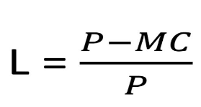
2) Lerner’s Index of Monopoly Power
Economist Lerner has given the following precise index of monopoly power.
LERNER INDEX = (PRICE - MARGINAL COST) / PRICE
When competition is pure or perfect, price(P) is equal to marginal cost and therefore Lerner’s index of monopoly power is equal to zero indicating no monopoly power at all.
When MC is zero, L will be equal to unity . Thus, Lerner’s index of monopoly power can vary from zero to unity.

Slide 31
3) Cross Elasticity of Demand as a Measure of Monopoly Power
The cross elasticity of demand points to the degree of dependence of a firm’s products. The smaller the extent of cross elasticity of demand for the product of a firm, the greater the degree of monopoly power enjoyed by it and vice-versa.

Slide 32
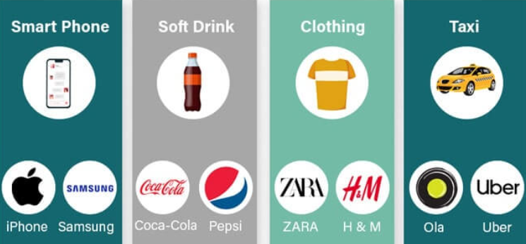
3. MONOPOLISTIC COMPETITION
It is defined as a market structure in which there are many firms selling closely related but unidentical commodity, for example detergents, automobiles, soft drinks, TV sets. Monopolistic competition is the form of market in which there are large number of sellers of a particular product, but each seller sells somewhat differentiated product .

Slide 33
Features of Monopolistic Competition
Large Number of Buyers and Sellers: In the monopolistic competition, the number of sellers is large, but it is not unusually large. The firm under monopolistic competition can reasonably assume that any action on its part will affect the rival firms so insignificantly that it need not bother about the reactions of the rival firms, it can follow its independent price policy.
Product Differentiation: The product of the sellers are differentiated but are close substitutes of one another. Product differentiation can be real or artificial. Its effect is that sellers can differentiate their products. This gives the seller some degree of price-making power, which he can exploit, that is why firms faces an elastic demand curve.

Slide 34
Free Entry and Exit of Firms: There are no restrictions to the entry of new firms to produce the close substitutes. Free entry would ensure that there are no abnormal profits. Similarly, free exit would ensure that no firm incurs losses in the long run.
Imperfect Knowledge: Buyers and sellers do not have perfect or complete knowledge of market conditions.
Selling Cost : A firm under monopolistic competition incurs selling cost to increase the demand for its product. Examples of selling costs are advertisements, and window displays.

Slide 35


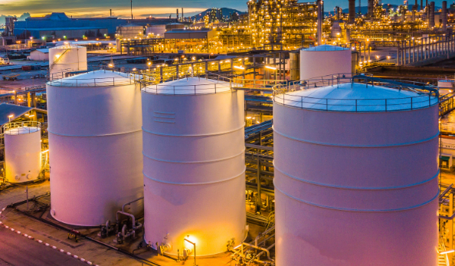
4. OLIGOPOLY
Oligopoly is defined as a market organization in which there are a few sellers of the homogeneous or differentiated products. The number of sellers depends on the size of the market.
Examples of oligopolies can be found across major industries like oil and gas, airlines, and telecom.

Slide 36
OPEC
OPEC’s ( Organisation of Petroleum Exporting Countries ) – Objective is to coordinate and unify petroleum policies among Member Countries, in order to secure fair and stable prices for petroleum producers.
Member countries in this group…?

Slide 37
Features of Oligopoly
Few Sellers
Homogeneous or Differentiated Products
Mutual Independence: This is the only feature which sets oligopoly apart from other markets structures. It means that price and output decisions of one firm affects the similar decisions of other firms.
Importance of Selling Cost
Indeterminate Demand Curve of an Oligopoly: An important feature of oligopoly is that the demand curve faced by an oligopolist is indeterminate. Any change in the price by one firm may result in a change in prices by the rival firms. Therefore, it is not definite, it is indeterminate .

Slide 38
Collusive Oligopoly & Non–Collusive Oligopoly
Collusive Oligopoly
Group of producers come together to collectively increase profit .
Cartels aiming at joint profit maximization.
Market sharing cartels
This is most common and popular
More freedom on the style of their output, their selling activities .
Non-competitive agreements .
Non–Collusive Oligopoly – situation where the firms compete with each other rather than cooperating .

Slide 39
Market Structures – summary of features:
 | Number of Firms | Influence on Price | Product Differentiation | Advertising | Barriers to Entry
Perfect Competition | Many | None | No | No | None
Monopolistic Competition | Many | Limited | Some | Yes | Limited
Oligopoly | Few | Some | Some | Yes | Significant
Pure Monopoly | One | Extensive | No | Yes | Complete

Slide 40
Types of Firms (just for your understanding)
Sole Proprietorship
Partnership
Corporations

Slide 41
Sole Proprietorship
Advantages
Ease of start-up
Full control
Easy to close
Disadvantages
Unlimited personal liability
Limited access to resources (including financial capital)
Limited life
Sole receiver of profit

Slide 42
Partnerships
Articles of partnership or partnership agreement define rights and responsibilities
Types of partnerships
General partnerships
Limited partnerships
Limited liability partnerships

Slide 43
Partnerships
Advantages
Ease of start-up
Shared decisionmaking
Disadvantages
Unlimited personal liability
Potential for conflict
Ability to specialize
More access to financial capital
Profit comes directly to partners
Limited life

Slide 44
Corporations
Articles of incorporation create an independent entity
Owners are called shareholders
Shares may or may not be publicly traded
Shareholders elect board of directors
Board of directors selects leadership of the firm

Slide 45
Corporations
Advantages
Ease of raising capital
Limited liability for owners
Disadvantages
Expense and difficulty of start-up
Transferable ownership
Unlimited life
Ability to hire experts
Double taxation
Owner-agent dilemma
Increased regulation and requirements

